Slide 1
Chapter3
Public-Key Cryptography and
Message Authentication

Slide 2
Cryptography Project
Find a partner to form a team
Develop your own RSA method and distribute your public key
  Windows or Linux?
  You may also distribute your own RSA executable for decryption if you don’t trust your partner
Encryption
  Encrypt a plaintext English paragraph (meaningful, at least 100 chars) using your own RSA program with your private key and send it as ciphertext 1 to your partner
  Encrypt a plaintext English paragraph (meaningful, at least 100 chars) with your partner’s public key and send it as ciphertext 2 back to your partner
Decryption
  Upon the receipt of ciphertext 1, use the sender’s public key to decrypt the message and give the sender a credit of 1 or 0 if you can or cannot read the produced plaintext
  Upon the receipt of ciphertext 2, use your own private key to decrypt the message and give the sender a credit of 1 or 0 if you can or cannot read the produced plaintext
Score
  The score of your project is the number of credits you receive from your partner
  Send the TA the score of your partner
  Submission deadline: the mid night before the last class

Slide 3
OUTLINE
Math Foundation
Public-Key Cryptography Principles
Public-Key Cryptography Algorithms
Digital Signatures
Key Management
Approaches to Message Authentication
Secure Hash Functions and HMAC

Slide 4
Introduction
(Math Background)
Finite fields
  Of increasing importance in cryptography
    Public Key, AES, Elliptic Curve, IDEA
  Concern operations on “numbers”
    What constitutes a “number”?
    The type of operations (+, -, x, /) varies considerably
We start with concepts of groups, rings, fields from abstract algebra
Notes:
Finite fields have become increasingly important in cryptography. A number of cryptographic algorithms rely heavily on properties of finite fields, such as the AES, Elliptic Curve, IDEA, & various Public Key algorithms. Groups, rings, and fields are the fundamental elements of abstract algebra, which is concerned with sets on whose elements (“numbers”) we can operate algebraically.

Slide 5
Group
Group
  a set of elements or “numbers”
  obeys:
    Closure: result of addition operation “+” is also in the set
    associative law: (a+b)+c = a+(b+c)
    has identity e: e+a = a+e = a
      0 is the identity element of addition
        What is the identity element of multiplication?
    has inverse a⁻¹: a+a⁻¹ = e
      Addition: a⁻¹ = -a
Abelian (commutative) group
  if commutative: a+b = b+a
Notes:
Now define some important concepts in abstract algebra - starting with a Group. In abstract algebra, we are concerned with sets on whose elements we can operate algebraically; that is, we can combine two elements of the set to obtain a third element of the set. These operations are subject to specific rules, which define the nature of the set. A group is such a set with properties listed above. We denote a Group as {G,.} We have used . as operator: could be addition +, multiplication x or any other mathematical operator. A group can have a finite (fixed) number of elements, or it may be infinite. Note that integers (+ve, -ve and 0) using addition form an infinite abelian group. So do real numbers using multiplication.

Slide 6
Cyclic Group
Exponentiation
  Repeated application of operator
  example: a³ = a.a.a
Identity:
  e=a⁰
Cyclic group
  every element is a power of some fixed element
    i.e. b = a^{k} for some a and every b in group
    a: a generator of the group
Notes:
Define exponentiation in a group as the repeated use of the group operator. Note that we are most familiar with it being applied to multiplication, but it is more general than that.
If the repeated use of the operator on some value a in the group results in every possible value being created, then the group is said to be cyclic, and a is a generator of (or generates) the group G.

Slide 7
Ring
Ring
  Is an Abelian group
  with both addition and multiplication operators
    has closure
    is associative
    distributive over addition: a(b+c) = ab + ac
Commutative ring
  Is a ring
  multiplication is commutative
Integral domain
  Is a commutative ring
  multiplication has an identity
  no zero divisors
Notes:
Next describe a ring. In essence, a ring is a set in which we can do addition, subtraction [a – b = a + (–b)], and multiplication without leaving the set. We denote a Ring as {R,+,.}
With respect to addition and multiplication, the set of all n-square matrices over the real numbers form a ring. The set of integers with addition & multiplication form an integral domain.

Slide 8
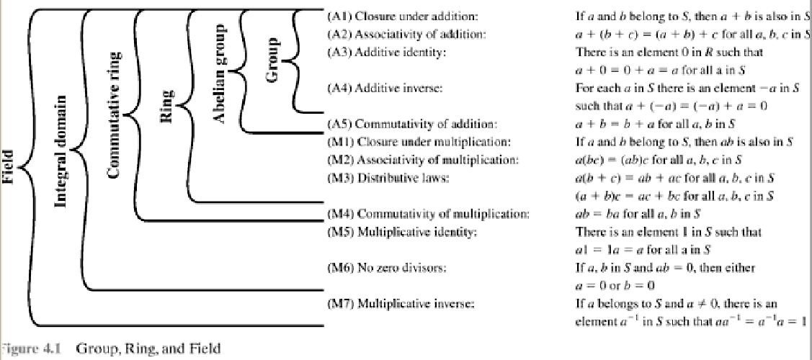
Field
Field
  Is an integral domain
  Allows for division
  Has multiplicative inverse
Hierarchy
Notes:
Lastly define a field. In essence, a field is a set in which we can do addition, subtraction, multiplication, and division without leaving the set. Division is defined with the following rule: a/b = a (b^{–1}). We denote a Field as {F,+,.}
Examples of fields are: rational numbers, real numbers, complex numbers. Note that integers are NOT a field since there are no multiplicative inverses (except for 1).
These are terms we use for different sorts of "number systems", ones obeying different sets of laws. From group to ring to field we get more and more laws being obeyed, see Stallings Figure 4.1.
As a memory aid, can use the acronym for groups: CAIN (Closure Associative Identity iNverse) & ABEL. Mostly we need to compute with Rings, if not Fields. When we do arithmetic modulo a prime, we have a field.

Slide 9
Modular Arithmetic
modulo operator
  “a mod n”: remainder when a is divided by n
congruence: a = b mod n
  a & b have the same remainder when divided by n
  eg. 100 = 34 mod 11
residue of “a mod n”
  b is the residue: a = qn + b
  usually choose the smallest positive remainder as residue
    ie. 0 <= b <= n-1
modulo reduction
    eg. -12 mod 7
    = -5 mod 7 = 2 mod 7 = 9 mod 7
Notes:
Given any positive integer n and any nonnegative integer a, if we divide a by n, we get an integer quotient q and an integer remainder r. In modular arithmetic we are only interested in the remainder (or residue) after division by some modulus, and results with the same remainder are regarded as equivalent. Two integers a and b are said to be congruent modulo n, if (a mod n) =(b mod n).

Slide 10
Divisors
A non-zero number b divides a if
  for some m have a=mb (a,b,m all integers)
  b divides into a with no remainder
  denoted as b|a
  b is a divisor of a
    eg. all of 1,2,3,4,6,8,12,24 divide 24
Notes:
Define concept of “divisors”. We say that a nonzero b divides a if a=m.b for some m, where a, b, and m are integers. That is, b divides a if there is no remainder on division. Can denote this as b|a, and say that b is a divisor of a. For example, the positive divisors of 24 are 1,2,3,4,6,8,12, and 24.

Slide 11
Modular Arithmetic Operations
A type of 'clock arithmetic'
uses a finite number of values, and loops back from either end
modular arithmetic
  addition & multiplication
  Apply modulo reduction at any point
    a+b mod n = [a mod n + b mod n] mod n
Notes:
Modular arithmetic is where we perform arithmetic operations within the confines of some set of integers mod n. It uses a finite number of values, and loops back from either end where needed.
When reducing, we "usually" want to find the positive remainder after dividing by the modulus. For positive numbers, this is simply the normal remainder. For negative numbers we have to "overshoot" (ie find the next multiple larger than the number) and "come back" (ie add a positive remainder to get the number); rather than have a "negative remainder".
Then note some important properties of modular arithmetic which mean you can modulo reduce at any point and obtain an equivalent answer.

Slide 12
Modular Arithmetic
modular arithmetic
  Applied to any group of integers
    Z_{n} = {0, 1, … , n-1}
  form a commutative ring for addition
  with a multiplicative identity
some properties
  if (a+b)=(a+c) mod n
  then b=c mod n
  but if (a.b)=(a.c) mod n
  then b=c mod n only if a is relatively prime to n
Notes:
Note some more important properties of modular arithmetic, as discussed further in the text.

Slide 13
Modulo 8 Addition Example
+ | 0 | 1 | 2 | 3 | 4 | 5 | 6 | 7
0 | 0 | 1 | 2 | 3 | 4 | 5 | 6 | 7
1 | 1 | 2 | 3 | 4 | 5 | 6 | 7 | 0
2 | 2 | 3 | 4 | 5 | 6 | 7 | 0 | 1
3 | 3 | 4 | 5 | 6 | 7 | 0 | 1 | 2
4 | 4 | 5 | 6 | 7 | 0 | 1 | 2 | 3
5 | 5 | 6 | 7 | 0 | 1 | 2 | 3 | 4
6 | 6 | 7 | 0 | 1 | 2 | 3 | 4 | 5
7 | 7 | 0 | 1 | 2 | 3 | 4 | 5 | 6
Notes:
Example showing addition in GF(8), from Stallings Table 4.1a.

Slide 14
Greatest Common Divisor (GCD)
GCD (a,b) of a and b
  the largest number that divides evenly into both a and b
    E.g. GCD(60,24) = 12
relatively prime
  no common factors (except 1)
    Eg. GCD(8,15) = 1
    hence 8 & 15 are relatively prime
?
Notes:
One of the basic techniques of number theory is the Euclidean algorithm, which is a simple procedure for determining the greatest common divisor of two positive integers. Use the notation gcd(a,b) to mean the greatest common divisor of a and b. The positive integer c is said to be the greatest common divisor of a and b if c is a divisor of a and of b; and any divisor of a and b is a divisor of c.
State that two integers a and b are relatively prime if their only common positive integer factor is 1, ie GCD(a,b)=1.

Slide 15
Euclidean Algorithm
Euclidean Algorithm
  an efficient way to find the GCD(a,b)
  uses theorem:
    GCD(a,b) = GCD(b, a mod b)
Euclidean Alg. to compute GCD(a,b):
  EUCLID(a,b)
  1. A = a; B = b
  2. if B = 0 return A = gcd(a, b)
  3. R = A mod B
  4. A = B
  5. B = R
  6. goto 2
Notes:
The Euclidean algorithm is an efficient way to find the GCD(a,b). The Euclidean algorithm is derived from the observation that if a & b have a common factor d (ie. a=m.d & b=n.d) then d is also a factor in any difference between them, vis: a-p.b = (m.d)-p.(n.d) = d.(m-p.n). Euclid's Algorithm keeps computing successive differences until it vanishes, at which point the greatest common divisor has been reached.

Slide 16
Example GCD(1970,1066)
1970 = 1 x 1066 + 904 gcd(1066, 904)
1066 = 1 x 904 + 162 gcd(904, 162)
904 = 5 x 162 + 94 gcd(162, 94)
162 = 1 x 94 + 68 gcd(94, 68)
94 = 1 x 68 + 26 gcd(68, 26)
68 = 2 x 26 + 16 gcd(26, 16)
26 = 1 x 16 + 10 gcd(16, 10)
16 = 1 x 10 + 6 gcd(10, 6)
10 = 1 x 6 + 4 gcd(6, 4)
6 = 1 x 4 + 2 gcd(4, 2)
4 = 2 x 2 + 0 gcd(2, 0)
Notes:
Illustrate how we can compute successive instances of GCD(a,b) = GCD(b,a mod b), example taken from text.
Note this MUST always terminate since will eventually get a mod b = 0 (ie no remainder left).
Answer is then the last non-zero value. In this case GCD(1970,1066)=2.

Slide 17
Galois Fields
finite fields play a key role in cryptography
Galois fields
  The number of elements in a finite field must be a power of a prime: p^{n}
  denoted GF(p^{n})
in particular often use the fields:
  GF(p)
  GF(2^{n})
Notes:
Infinite fields are not of particular interest in the context of cryptography. However, finite fields play a crucial role in many cryptographic algorithms. It can be shown that the order of a finite field (number of elements in the field) must be a positive power of a prime, & these are known as Galois fields & denoted GF(p^n). We are most interested in the cases where either n=1 - GF(p), or p=2 - GF(2^n).

Slide 18
Galois Fields GF(p)
GF(p)
  the set of integers {0,1, … , p-1}
  arithmetic operations modulo prime p
these form a finite field
  since have multiplicative inverses
arithmetic is “well-behaved”
  do addition, subtraction, multiplication, and division without leaving the field GF(p)
Notes:
Start by considering GF(p) over the set of integers {0…p-1} with addition & multiplication modulo p. This forms a “well-behaved” finite field.

Slide 19
GF(7) Multiplication Example
× | 0 | 1 | 2 | 3 | 4 | 5 | 6
0 | 0 | 0 | 0 | 0 | 0 | 0 | 0
1 | 0 | 1 | 2 | 3 | 4 | 5 | 6
2 | 0 | 2 | 4 | 6 | 1 | 3 | 5
3 | 0 | 3 | 6 | 2 | 5 | 1 | 4
4 | 0 | 4 | 1 | 5 | 2 | 6 | 3
5 | 0 | 5 | 3 | 1 | 6 | 4 | 2
6 | 0 | 6 | 5 | 4 | 3 | 2 | 1
Notes:
Example showing multiplication in GF(7), from Stallings Table 4.3b.

Slide 20
Finding Inverses
Find inverse of b in GF(m)
(Used in RSA)
EXTENDED EUCLID(m, b)
1. (A1, A2, A3)=(1, 0, m);
  (B1, B2, B3)=(0, 1, b)
  2. if B3 = 0
  return A3 = gcd(m, b); no inverse
  3. if B3 = 1
  return B3 = gcd(m, b); B2 = b^{–1} mod m
  4. Q = A3 div B3
  5. (T1, T2, T3)=(A1 – Q B1, A2 – Q B2, A3 – Q B3)
  6. (A1, A2, A3)=(B1, B2, B3)
  7. (B1, B2, B3)=(T1, T2, T3)
  8. goto 2
Notes:
An important problem is to find multiplicative inverses in such finite fields. Can show that such inverses always exist, & can extend the Euclidean algorithm to find them as shown. See text for discussion as to why this works.

Slide 21
Inverse of 550 in GF(1759)
Q | A1 | A2 | A3 | B1 | B2 | B3
— | 1 | 0 | 1759 | 0 | 1 | 550
3 | 0 | 1 | 550 | 1 | –3 | 109
5 | 1 | –3 | 109 | –5 | 16 | 5
21 | –5 | 16 | 5 | 106 | –339 | 4
1 | 106 | –339 | 4 | –111 | 355 | 1
Notes:
Example showing how to find the inverse of 550 in GF(1759), from Stallings Table 4.4.

Slide 22
Polynomial Arithmetic
Compute using polynomials
  f(x) = a_{n}x^{n} + a_{n-1}x^{n-1} + … + a₁x + a₀ = ∑ a_{i}x^{i}
    x is known as the indeterminate
    not interested in any specific value of x
several alternatives available
  ordinary polynomial arithmetic
  poly arithmetic with coeff mod p
  polynomials mod division
Notes:
Next introduce the interesting subject of polynomial arithmetic, using polynomials in a single variable x, with several variants as listed above.
Note we are usually not interested in evaluating a polynomial for any particular value of x, which is thus referred to as the indeterminate.

Slide 23
Ordinary Polynomial Arithmetic
add or subtract corresponding coefficients
multiply all terms by each other
eg
  let f(x) = x³ + x² + 2 and g(x) = x² – x + 1
  f(x) + g(x) = x³ + 2x² – x + 3
  f(x) – g(x) = x³ + x + 1
  f(x) x g(x) = x⁵ + 3x² – 2x + 2
Notes:
Polynomial arithmetic includes the operations of addition, subtraction, and multiplication, defined in the usual way, ie add or subtract corresponding coefficients, or multiply all terms by each other. The examples are from the text, with working in Stallings Figure 4.3.

Slide 24
Polynomial Arithmetic with Modulo Coefficients
computing value of each coefficient
  do calculation modulo some value
  forms a polynomial ring
  could be modulo any prime
We are most interested in mod 2
  ie. all coefficients are 0 or 1
  eg. let f(x) = x³ + x² and g(x) = x² + x + 1
  f(x) + g(x) = x³ + x + 1
  f(x) x g(x) = x⁵ + x²
Notes:
Consider variant where now when computing value of each coefficient do the calculation modulo some value, usually a prime. If the coefficients are computed in a field (eg GF(p)), then division on the polynomials is possible, and we have a polynomial ring. Are most interested in using GF(2) - ie all coefficients are 0 or 1, and any addition/subtraction of coefficients is done mod 2 (ie 2x is the same as 0x!), which is just the common XOR function.

Slide 25
Polynomial Division
Can write any polynomial in the form:
  f(x) = q(x) g(x) + r(x)
  r(x): a remainder
    r(x) = f(x) mod g(x)
g(x) divides f(x) evenly
  if have no remainder
A polynomial is irreducible (or prime)
  if f(x) has no divisors other than itself & 1
Notes:
Note that we can write any polynomial in the form of f(x) = q(x) g(x) + r(x), where division of f(x) by g(x) results in a quotient q(x) and remainder r(x). Can then extend the concept of divisors from the integer case, and show that the Euclidean algorithm can be extended to find the greatest common divisor of two polynomials whose coefficients are elements of a field.
Define an irreducible (or prime) polynomial as one with no divisors other than itself & 1. If compute polynomial arithmetic modulo an irreducible polynomial, this forms a finite field, and the GCD & Inverse algorithms can be adapted for it.

Slide 26
Polynomial GCD
Greatest common divisor for polys
  c(x) = GCD(a(x), b(x))
  if c(x) is the poly of greatest degree which divides both a(x), b(x)
adapt Euclid’s Algorithm to find it:
  EUCLID[a(x), b(x)]
  1. A(x) = a(x); B(x) = b(x)
  2. if B(x) = 0 return A(x) = gcd[a(x), b(x)]
  3. R(x) = A(x) mod B(x)
  4. A(x) ¨ B(x)
  5. B(x) ¨ R(x)
  6. goto 2
Notes:
We can extend the analogy between polynomial arithmetic over a field and integer arithmetic by defining the greatest common divisor as shown.

Slide 27
Modular Polynomial Arithmetic
Field GF(2^{n})
  polynomials with coefficients modulo 2
  whose degree is less than n
    hence must reduce modulo an irreducible poly of degree n (for multiplication only)
  form a finite field
  can always find an inverse
    extend Euclid’s Inverse algorithm to find
Notes:
Consider now the case of polynomial arithmetic with coordinates mod 2 and polynomials mod an irreducible polynomial m(x). That is Modular Polynomial Arithmetic uses the set S of all polynomials of degree n-1 or less over the field Zp. With the appropriate definition of arithmetic operations, each such set S is a finite field. The definition consists of the following elements:
Arithmetic follows the ordinary rules of polynomial arithmetic using the basic rules of algebra, with the following two refinements.
2. Arithmetic on the coefficients is performed modulo p.
3. If multiplication results in a polynomial of degree greater than n-1, then the polynomial is reduced modulo some irreducible polynomial m(x) of degree n. That is, we divide by m(x) and keep the remainder.
This forms a finite field. And just as the Euclidean algorithm can be adapted to find the greatest common divisor of two polynomials, the extended Euclidean algorithm can be adapted to find the multiplicative inverse of a polynomial.

Slide 28
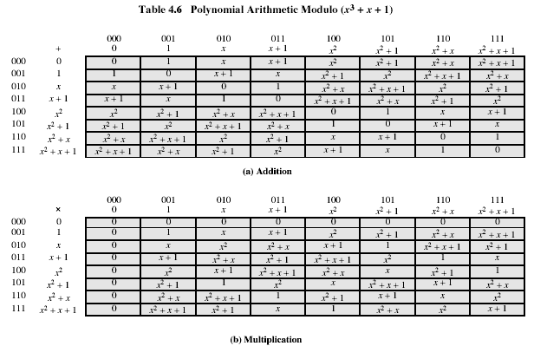
Example GF(2³)
Notes:
Example shows addition & multiplication in GF(2³) modulo (x³+x+1), from Stallings Table 4.6.

Slide 29
Computational Considerations
coefficients are 0 or 1
  represent any such polynomial as a bit string
Addition
  becomes XOR of these bit strings
Multiplication
  shift & XOR
Modulo reduction
  repeatedly substituting highest power with remainder of irreducible poly (also shift & XOR)
Notes:
A key motivation for using polynomial arithmetic in GF(2^{n}) is that the polynomials can be represented as a bit string, using all possible bit values, and the calculations only use simple common machine instructions - addition is just XOR, and multiplication is shifts & XOR’s. See text for additional discussion. The shortcut for polynomial reduction comes from the observation that if in GF(2^{n}) then irreducible poly g(x) has highest term x^{n} , and if compute x^{n} mod g(x) answer is g(x)- x^{n}

Slide 30
Computational Example
GF(2³)
  (x²+1): 101₂
  (x²+x+1): 111₂
Addition:
  (x²+1) + (x²+x+1) = x
  101 XOR 111 = 010₂
Multiplication:
  (x+1).(x²+1) = x.(x²+1) + 1.(x²+1)
  = x³+x+x²+1 = x³+x²+x+1
  011.101 = (101)<<1 XOR (101)<<0 =
  1010 XOR 101 = 1111₂
Polynomial modulo reduction (get q(x) & r(x))
  (x³+x²+x+1 ) mod (x³+x+1) = 1.(x³+x+1) + (x²) = x²
  1111 mod 1011 = 1111 XOR 1011 = 0100₂
Notes:
Show here a few simple examples of addition, multiplication & modulo reduction in GF(2³).
Note the long form modulo reduction finds p(x)=q(x).m(x)+r(x) with r(x) being the desired remainder.

Slide 31
Prime Numbers
prime numbers only have divisors of 1 and self
  they cannot be written as a product of other numbers
  note: 1 is prime, but is generally not of interest
  eg. 2,3,5,7 are prime, 4,6,8,9,10 are not
prime numbers are central to number theory
list of prime number less than 200 is:
  2 3 5 7 11 13 17 19 23 29 31 37 41 43 47 53 59 61 67 71 73 79 83 89 97 101 103 107 109 113 127 131 137 139 149 151 157 163 167 173 179 181 191 193 197 199
Notes:
A central concern of number theory is the study of prime numbers. Indeed, whole books have been written on the subject. An integer p>1 is a prime number if and only if its only divisors are 1 and itself. Prime numbers play a critical role in number theory and in the techniques discussed in this chapter. Stallings Table 8.1 (excerpt above) shows the primes less than 2000. Note the way the primes are distributed. In particular note the number of primes in each range of 100 numbers.

Slide 32

Prime Factorization
factor a number n
  a product of other numbers: n=a x b x c
  factoring a number is relatively hard compared to multiplying the factors together to generate the number
prime factorization of a number n
  a product of primes
    eg. 91=7x13 ; 3600=2⁴x3²x5²
Notes:
The idea of "factoring" a number is important - finding numbers which divide into it. Taking this as far as can go, by factorising all the factors, we can eventually write the number as a product of (powers of) primes - its prime factorisation. Note also that factoring a number is relatively hard compared to multiplying the factors together to generate the number.

Slide 33
Relatively Prime Numbers & GCD
relatively prime
  two numbers a, b have no common divisors apart from 1
    eg. 8 & 15 are relatively prime since factors of 8 are 1,2,4,8 and of 15 are 1,3,5,15 and 1 is the only common factor
A new approach to determine GCD
  comparing their prime factorizations and using least powers
    eg. 300=2¹x3¹x5² 18=2¹x3²
    hence GCD(18,300)=2¹x3¹x5⁰=6
Notes:
Have the concept of “relatively prime” if two number share no common factors other than 1.
Another common problem is to determine the "greatest common divisor” GCD(a,b) which is the largest number that divides into both a & b.

Slide 34
Fermat's Theorem
a^{p-1} = 1 (mod p)
  where p is prime and gcd(a,p)=1
  also known as Fermat’s Little Theorem
  For primality test
Notes:
Two theorems that play important roles in public-key cryptography are Fermat’s theorem and Euler’s theorem.
Fermat’s theorem (also known as Fermat’s Little Theorem) as listed above, states an important property of prime numbers. See Stallings section 8.2 for its proof.

Slide 35
Euler Totient Function ø(n)
arithmetic modulo n
  complete set of residues
    0..n-1
  reduced set of residues
    those numbers (residues) which are relatively prime to n
    eg for n=10,
      complete set of residues is {0,1,2,3,4,5,6,7,8,9}
      reduced set of residues is {1,3,7,9}
Euler Totient Function ø(n)
  number of elements in reduced set of residues
Notes:
Now introduce the Euler’s totient function ø(n), defined as the number of positive integers less than n & relatively prime to n. Note the term “residue” refers to numbers less than some modulus, and the “reduced set of residues” to those numbers (residues) which are relatively prime to the modulus (n). Note by convention that ø(1) = 1.

Slide 36
Euler Totient Function ø(n)
compute ø(n)
  need to count number of residues to be excluded
  eg.
  ø(37) = 36
  ø(21) = (3–1)x(7–1) = 2x6 = 12
in general need prime factorization, but
  for p (p prime) ø(p) = p-1
  for p.q (p,q prime) ø(pq) =(p-1)x(q-1)
Notes:
To compute ø(n) need to count the number of residues to be excluded. In general you need use a complex formula on the prime factorization of n, but have a couple of special cases as shown.

Slide 37
Euler's Theorem
a generalisation of Fermat's Theorem
a^{ø(n)} = 1 (mod n)
  for any a,n where gcd(a,n)=1
eg.
  a=3;n=10; ø(10)=4;
  hence 3⁴ = 81 = 1 mod 10
  a=2;n=11; ø(11)=10;
  hence 2¹⁰ = 1024 = 1 mod 11
Key to understand RSA method!
Notes:
Euler's Theorem is a generalization of Fermat's Theorem for any number n. See Stallings section 8.2 for its proof.

Slide 38
Miller Rabin Algorithm
Primality test based on Fermat’s Theorem
algorithm:
  TEST (n):
  1. Find integers k, q, (k > 0, q odd), so that (n–1)=2^{k}q
  2. Select a random integer a, 1<a<n–1
  3. if a^{q} mod n = 1 then return (“maybe prime");
  4. for j = 0 to k – 1 do
  5. if (a^{2jq} mod n = n-1)
  then return(" maybe prime ")
  6. return ("composite") //definitely not prime
Notes:
The algorithm shown is due to Miller and Rabin is typically used to test a large number for primality. See Stallings section 8.3 for its proof, which is based on Fermat’s theorem.

Slide 39
Chinese Remainder Theorem
Chinese Remainder theorem
  used to speed up modulo computations
  divide modulo into a product of numbers
    eg. mod M = m₁m₂..m_{k}
  work on each moduli m_{i} separately
  faster than working in the full modulus M
    computational cost is proportional to size
Notes:
One of the most useful results of number theory is the Chinese remainder theorem (CRT), so called because it is believed to have been discovered by the Chinese mathematician Sun-Tse in around 100 AD. It is very useful in speeding up some operations in the RSA public-key scheme, since it allows you to do perform calculations modulo factors of your modulus, and then combine the answers to get the actual result. Since the computational cost is proportional to size, this is faster than working in the full modulus sized modulus.

Slide 40
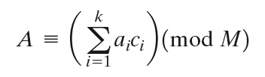

Chinese Remainder Theorem
can implement CRT in several ways
compute A(mod M)
  first compute all a_{i} = A mod m_{i} separately
  determine constants c_{i} below, where M_{i} = M/m_{i}
  then combine results to get answer using:
Notes:
One of the useful features of the Chinese remainder theorem is that it provides a way to manipulate (potentially very large) numbers mod M, in terms of tuples of smaller numbers.This can be useful when M is 150 digits or more. However note that it is necessary to know beforehand the factorization of M. See worked examples in Stallings section 8.4.

Slide 41
Primitive Roots
from Euler’s theorem: a^{ø(n)} mod n=1
consider a^{m}=1 (mod n), GCD(a,n)=1
  must exist for m = ø(n) but may be smaller
  once powers reach m, cycle will repeat
a is called a primitive root
  if the smallest is m = ø(n)
a is a primitive root of prime p
  if a mod p, a^2 mod p, …, a^(p-1)mod p are distinct and consist of 1, 2,…, (p-1) in some permutation
  Or, the powers of a "generate" the group mod p
useful but relatively hard to find
Notes:
Consider the powers of an integer modulo n. By Eulers theorem, for every relatively prime a, there is at least one power equal to 1 (being ø(n)), but there may be a smaller value. If the smallest value is m = ø(n) then a is called a primitive root. If n is prime, then the powers of a primitive root “generate” all residues mod n. Such generators are very useful, and are used in a number of public-key algorithms, but they are relatively hard to find.

Slide 42
Discrete Logarithms
inverse problem to exponentiation
  find the discrete logarithm of a number modulo p
  find i such that b = a^{i} (mod p) , 0 <= i <= p-1
    i = log_{a} b (mod p) = dloga,p(b)
      Here, “i” is also called index
if a is a primitive root then index always exists, otherwise it may not, eg.
    i = log₃ 4 mod 13 has no answer
    i = log₂ 3 mod 13 = 4 by trying successive powers
whilst exponentiation is relatively easy, finding discrete logarithms is generally a hard problem
Notes:
Discrete logarithms are fundamental to a number of public-key algorithms, including Diffie-Hellman key exchange and the digital signature algorithm (DSA).
Discrete logs (or indices) share the properties of normal logarithms, and are quite useful. The logarithm of a number is defined to be the power to which some positive base (except 1) must be raised in order to equal that number. If working with modulo arithmetic, and the base is a primitive root, then an integral discrete logarithm exists for any residue.
However whilst exponentiation is relatively easy, finding discrete logs is not, in fact is as hard as factoring a number. This is an example of a problem that is "easy" one way (raising a number to a power), but "hard" the other (finding what power a number is raised to giving the desired answer). Problems with this type of asymmetry are very rare, but are of critical usefulness in modern cryptography.

Slide 43
Public-Key Cryptography Principles
The use of two keys has consequences
  key distribution, confidentiality and authentication.
The scheme has six ingredients
  Plaintext
  Encryption algorithm
  Public key
  private key
  Ciphertext
  Decryption algorithm

Slide 44
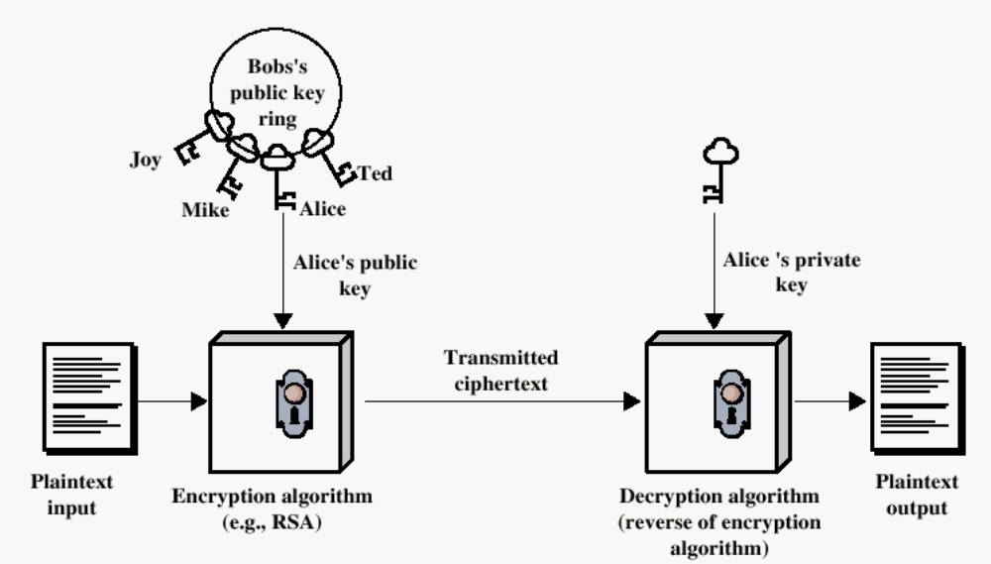
Encryption using Public-Key system

Slide 45
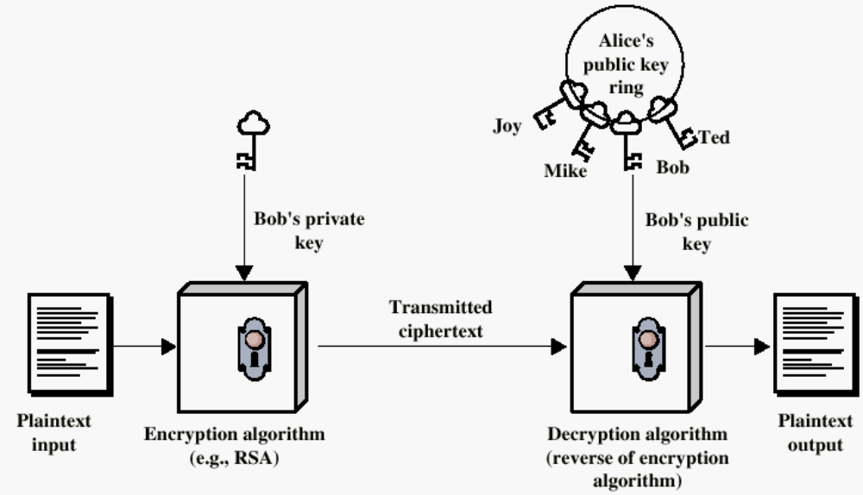
Authentication using Public-Key System

Slide 46

Public-Key Cryptosystems
Notes:
Stallings Figure 9.4 “Public-Key Cryptosystems: Secrecy and Authentication” illustrates the essential elements of a public-key encryption scheme.
Note that public-key schemes can be used for either secrecy or authentication, or both (as shown here).
In this case, separate key pairs are used for each of these purposes. The receiver owns and creates secrecy keys, sender owns and creates authentication keys.
In practice typically DO NOT do this, because of the computational cost of public-key schemes. Rather encrypt a session key which is then used with a block cipher to encrypt the actual message, and separately sign a hash of the message as a digital signature - this will be discussed more later.

Slide 47
Applications for Public-Key Cryptosystems
Three categories:
  Encryption/decryption
    The sender encrypts a message with the recipient’s public key.
  Digital signature
    The sender ”signs” a message with its private key.
  Key exchange
    Two sides cooperate to exhange a session key.

Slide 48
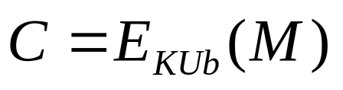
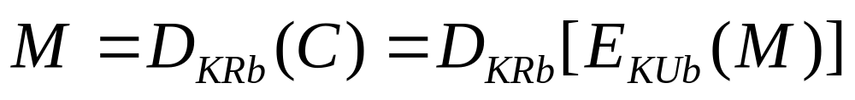
Requirements for Public-Key Cryptography
Computationally easy for a party B to generate a pair (public key KUb, private key KR_{b})
Easy for sender to generate ciphertext:
Easy for the receiver to decrypt ciphertect using private key:

Slide 49
Requirements for Public-Key Cryptography
Computationally infeasible to determine private key (KR_{b}) knowing public key (KU_{b})
Computationally infeasible to recover message M, knowing KU_{b} and ciphertext C
Either of the two keys can be used for encryption, with the other used for decryption:

Slide 50
Security of Public Key Schemes
brute force exhaustive search attack
  theoretically possible
  similar to secret key schemes
  keys used are very large (>512bits)
    Slower compared to secret key schemes
security relies on
  a large enough difference in difficulty between
    easy (en/decrypt) and
    hard (cryptanalyse) problems
  the hard problem is known, but is made hard enough to be impractical to break
Notes:
Public key schemes are no more or less secure than private key schemes - in both cases the size of the key determines the security. Note also that you can't compare key sizes - a 64-bit private key scheme has very roughly similar security to a 512-bit RSA - both could be broken given sufficient resources. But with public key schemes at least there is usually a firmer theoretical basis for determining the security since its based on well-known and well studied number theory problems.

Slide 51
Public-Key Cryptographic Algorithms
RSA and Diffie-Hellman
RSA
  Ron Rives, Adi Shamir and Len Adleman at MIT, 1977
  RSA is a block cipher
  The most widely implemented
Diffie-Hellman
  Exchange a secret key securely
  Compute discrete logarithms

Slide 52
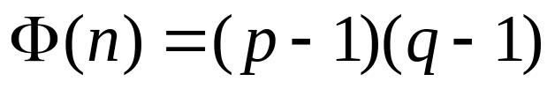
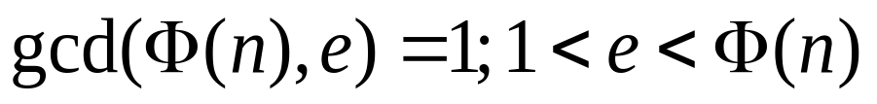
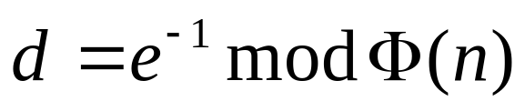
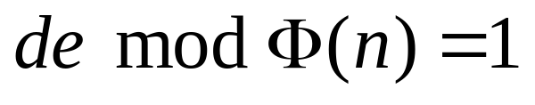
RSA Algorithm (team project)
Select p,q p and q both prime
Calculate n = p x q
Calculate
Select integer e:
Calculate d: ,
Public Key KU = {e,n}
Private key KR = {d,n}
Plaintext: M < n
Ciphertext: C = Me (mod n)
Ciphertext: C
Plaintext: M = C^{d} (mod n)

Slide 53
Why RSA Works
because of Euler's Theorem:
  a^{ø(n)}mod n = 1 where gcd(a,n)=1
RSA:
  n=p.q
  ø(n)=(p-1)(q-1)
  carefully chose e & d to be inverses mod ø(n)
    e.d=1+k.ø(n) for some k
  Prove C^{d} = M mod n?
  C^{d} = M^{e.d} = M^{1+k.ø(n)} = M¹.(M^{ø(n)})^{k}
= M¹.(1)^{k} = M¹ = M mod n
Notes:
Can show that RSA works as a direct consequence of Euler’s Theorem, so that raising a number to power e then d (or vica versa) results in the original number!

Slide 54
Example of RSA Algorithm
Select p = 17, q = 11 (both primes)
Calculate n = p x q = 187
Calculate = 160
Select integer e = 7, relatively prime to 160
Calculate d: dxe mod 160 = 1 → dxe = k 160 + 1
  23 x 7 = 161 = 1 x 160 + 1, d = 23
Public Key KU = {e,n} = {7, 187}
Private key KR = {d,n} = {23, 187}

Slide 55
Example of RSA Algorithm
Given message M = 88 (88 < 187)
  Encryption
    C = 88^7 mod 187 = ?
    = [(88^4 mod 187) x (88^2 mod 187) x (88^1 mod 187)] mod 187
    = [(59,969,536 mod 187) x (7744 mod 187) x (88)] mod 187
    = (132 x 77 x 88) mod 187
    = 894,432 mod 187
    = 11
  Decryption
    M = C^23 mod 187 = 88
    Exponentiation:
    23 = 16 (=8 + 8) + 4 + 2 + 1

Slide 56
Exponentiation
Square and Multiply Algorithm
  repeatedly squaring base
  multiplying in the ones that are needed to compute the result
  a fast, efficient algorithm for exponentiation
binary representation of exponent
  only takes O(log₂ n) multiples for number n
  eg. 7⁵ = 7⁴.7¹ = 3.7 = 10 mod 11
  eg. 3¹²⁹ = 3¹²⁸.3¹ = 5.3 = 4 mod 11
Notes:
To perform the modular exponentiations, you can use the “Square and Multiply Algorithm”, a fast, efficient algorithm for doing exponentiation.
The idea is to repeatedly square the base, and multiply in the ones that are needed to compute the result, as found by examining the binary representation of the exponent.

Slide 57
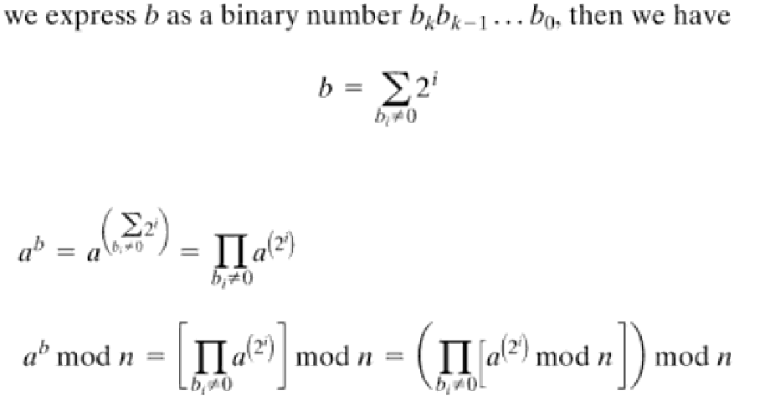
Exponentiation a^b mod n
Notes:
To perform the modular exponentiations, you can use the “Square and Multiply Algorithm”, a fast, efficient algorithm for doing exponentiation.
The idea is to repeatedly square the base, and multiply in the ones that are needed to compute the result, as found by examining the binary representation of the exponent.

Slide 58
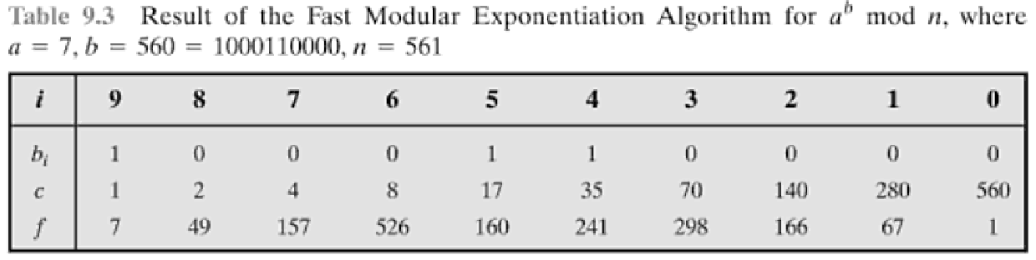
Exponentiation
Algorithm for computing a^b mod n
First represent b as a binary number: bkbk-1…b0.
c = 0; f = 1
for i = k downto 0
do c = 2 x c
f = (f x f) mod n
if b_{i} == 1 then
c = c + 1
f = (f x a) mod n
return f
Notes:
State here one version of the “Square and Multiply Algorithm”, from Stallings Figure 9.7.

Slide 59
Efficient Encryption
Encryption
  C = Me (mod n)
    uses exponentiation to power e
if e small, this will be faster
  often choose e=65537 (2¹⁶-1)
  Let’s also see choices of e=3 or e=17
    but if e too small (eg e=3), attack possible
      using Chinese remainder theorem & 3 messages with different modulii
if e fixed, must ensure gcd(e,ø(n))=1
  i.e. reject any p or q not relatively prime to e
Notes:
To speed up the operation of the RSA algorithm using the public key, can choose to use a small value of e (but not too small, since its then vulnerable to attack).
Must then ensure any p or q chosen are relatively prime to the fixed e (and reject and find another if not), for system to work.

Slide 60
Efficient Decryption
Decryption
  M = C^{d} (mod n)
    uses exponentiation to power d
  this is likely large, insecure if not
  can use the Chinese Remainder Theorem (CRT) to compute mod p & q separately, then combine to get desired answer
    approx 4 times faster than doing directly
    only owner of private key who knows values of p & q can use this technique
Notes:
To speed up the operation of the RSA algorithm using the private key, can use the Chinese Remainder Theorem (CRT) to compute mod p & q separately, and then combine results to get the desired answer. This is approx 4 times faster than calculating “C^d mod n” directly. Note that only the owner of the private key details (who knows the values of p & q) can do this, but of course that’s exactly where help is needed, since if e is small then d will be likely be large!

Slide 61
RSA Key Generation
users of RSA must:
  determine two primes at random - p, q
  select either e or d and compute the other
primes p,q must not be easily derived from modulus n=p.q
  must be sufficiently large
  typically guess and use probabilistic test
exponents e, d are inverses
  use Inverse algorithm to compute the other
Notes:
Before the application of the public-key cryptosystem, each participant must generate a pair of keys, which requires finding primes and computing inverses. Both the prime generation and the derivation of a suitable pair of inverse exponents may involve trying a number of alternatives. Typically make random guesses for a possible p or q, and check using a probabalistic primality test whether the guessed number is indeed prime. If not, try again. Note that the prime number theorem shows that the average number of guesses needed is not too large. Then compute decryption exponent d using Euclid’s Inverse Algorithm, which is quite efficient.

Slide 62
RSA Security
possible approaches to attacking RSA are:
  brute force key search
    infeasible given size of numbers
  mathematical attacks
    based on difficulty of computing ø(n)
    by factoring modulus n
  timing attacks
    on running of decryption
  chosen ciphertext attacks
    given properties of RSA
Notes:
Note some possible possible approaches to attacking the RSA algorithm, as shown.
The defense against the brute-force approach is the same for RSA as for other cryptosystems, namely, use a large key space. Thus the larger the number of bits in d, the better. However because the calculations involved both in key generation and in encryption/decryption are complex, the larger the size of the key, the slower the system will run.
Will now review the other possible types of attacks.

Slide 63
Factoring Problem
3 mathematical attack approaches
  factor n=p.q, hence compute ø(n) and then d
  determine ø(n) directly w/o knowing p&q and compute d
  find d directly w/o determining ø(n)
currently believe all equivalent to factoring
  have seen slow improvements over the years
  currently assume 1024-2048 bit RSA is secure
    ensure p, q of similar size and matching other constraints
Notes:
We can identify three approaches to attacking RSA mathematically, as shown. Mathematicians currently believe all equivalent to factoring.
See Stallings Table 9.4 for progress in factoring, where see slow improvements over the years, with the biggest improvements coming from improved algorithms.
The best current algorithm is the “Lattice Sieve” (LS), which replaced the “Generalized Number Field Sieve” (GNFS), which replaced the “Quadratic Sieve”(QS).
Have to assume computers will continue to get faster, and that better factoring algorithms may yet be found.
Numbers of size 1024-2048 bits look reasonable at present, provided the factors meet other constraints.

Slide 64
Timing Attacks
developed by Paul Kocher in mid-1990’s
exploit timing variations in operations
  eg. multiplying by small vs large number
infer operand size based on time taken
RSA exploits time taken in exponentiation
countermeasures
  use constant exponentiation time
  add random delays
  blind values used in calculations
Notes:
Had a new category of attacks developed by Paul Kocher in mid-1990’s, based on observing how long it takes to compute the cryptographic operations. Timing attacks are applicable not just to RSA, but to other public-key cryptography systems. This attack is alarming for two reasons: It comes from a completely unexpected direction and it is a ciphertextonly attack. A timing attack is somewhat analogous to a burglar guessing the combination of a safe by observing how long it takes for someone to turn the dial from number to number.
Although the timing attack is a serious threat, there are simple countermeasures that can be used, including using constant exponentiation time algorithms, adding random delays, or using blind values in calculations.

Slide 65
Diffie-Hellman Key Exchange
first public-key type scheme proposed
  by Diffie & Hellman in 1976 along with the exposition of public key concepts
    note: now know that Williamson (UK CESG) secretly proposed the concept in 1970
  is a practical method for public exchange of a secret key
  used in a number of commercial products
Notes:
The idea of public key schemes, and the first practical scheme, which was for key distribution only, was published in 1977 by Diffie & Hellman. The concept had been previously described in a classified report in 1970 by Williamson (UK CESG) - and subsequently declassified in 1987, see [ELLI99].

Slide 66
Diffie-Hellman Key Exchange
a public-key distribution scheme
  cannot be used to exchange an arbitrary message
  rather it can establish a common key
  known only to the two participants
Secret key
  depends on the participants
    their private and public key information
  based on exponentiation in a finite (Galois) field (modulo a prime or a polynomial) - easy
  security relies on the difficulty of computing discrete logarithms (similar to factoring) – hard
Notes:
The purpose of the algorithm is to enable two users to securely exchange a key that can then be used for subsequent encryption of messages. The algorithm itself is limited to the exchange of secret values, which depends on the value of the public/private keys of the participants. The Diffie-Hellman algorithm uses exponentiation in a finite (Galois) field (modulo a prime or a polynomial), and depends for its effectiveness on the difficulty of computing discrete logarithms.

Slide 67
Diffie-Hellman Setup
all users agree on global parameters:
  large prime integer or polynomial q
  α being a primitive root mod q
each user (eg. A) generates their key
  chooses a secret key (number): x_{A} < q
  compute their public key: y_{A} = α^{xA} mod q
each user makes public that key y_{A}
Notes:
In the Diffie-Hellman key exchange algorithm, there are two publicly known numbers: a prime number q and an integer a that is a primitive root of q. The prime q and primitive root a can be common to all using some instance of the D-H scheme. Note that the primitive root a is a number whose powers successively generate all the elements mod q. Users Alice and Bob choose random secrets x's, and then "protect" them using exponentiation to create their public y's. For an attacker monitoring the exchange of the y's to recover either of the x's, they'd need to solve the discrete logarithm problem, which is hard.

Slide 68
Diffie-Hellman Key Exchange
shared session key for users A & B is K_{AB}:
  K_{AB} = α^{xA.xB} mod q
  = y_{A}^{xB} mod q (which B can compute)
  = y_{B}^{xA} mod q (which A can compute)
K_{AB} is used as session key in private-key encryption scheme between Alice and Bob
if Alice and Bob subsequently communicate, they will have the same key as before, unless they choose new public-keys
To determine the private key of B, attacker must solve discrete log
  XB = dlog α,q (YB)
Notes:
The actual key exchange for either party consists of raising the others "public key' to power of their private key. The resulting number (or as much of as is necessary) is used as the key for a block cipher or other private key scheme. For an attacker to obtain the same value they need at least one of the secret numbers, which means solving a discrete log, which is computationally infeasible given large enough numbers. Note that if Alice and Bob subsequently communicate, they will have the same key as before, unless they choose new public-keys.

Slide 69
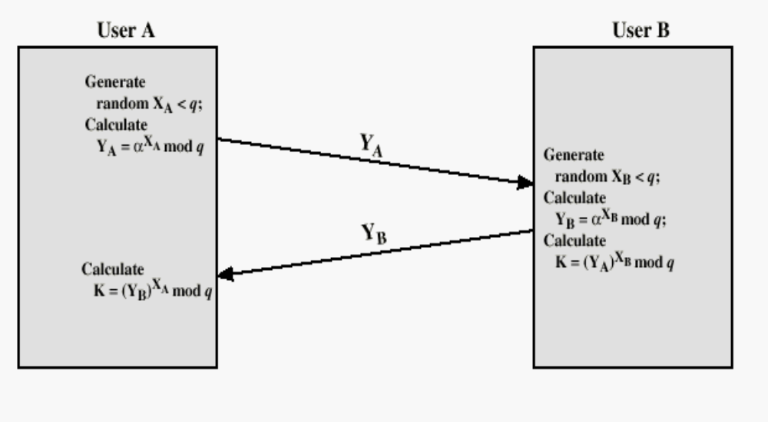
Diffie-Hellman Key Echange
Prove equal?

Slide 70
Diffie-Hellman Example
users Alice & Bob who wish to swap keys:
agree on prime q=353 and α=3
select random secret keys:
  A chooses x_{A}=97, B chooses x_{B}=233
compute respective public keys:
  y_{A}=3⁹⁷ mod 353 = 40 (Alice)
  y_{B}=3²³³ mod 353 = 248 (Bob)
compute shared session key as:
  K_{AB}= y_{B}^{xA} mod 353 = 248⁹⁷ = 160 (Alice)
  K_{AB}= y_{A}^{xB} mod 353 = 40²³³ = 160 (Bob)
Notes:
Here is an example of Diffie-Hellman from the text.

Slide 71
Other Public-Key Cryptographic Algorithms
Digital Signature Standard (DSS)
  Makes use of the SHA-1
  Not for encryption or key echange
Elliptic-Curve Cryptography (ECC)
  Good for smaller bit size
  Low confidence level, compared with RSA
  Very complex

Slide 72
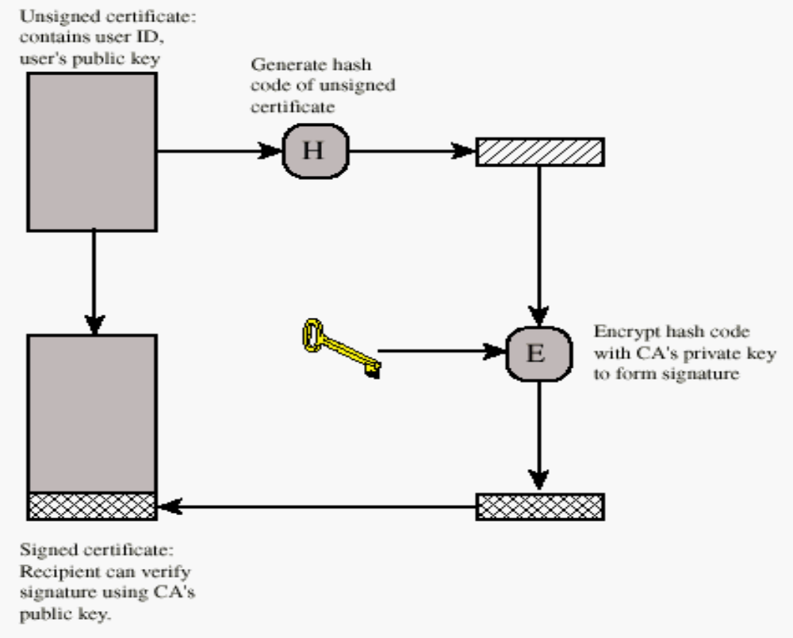
Public-Key Distribution
Digital Certificate

Slide 73
Authentication
Requirements - must be able to verify that:
1. Message came from apparent source or author,
2. Contents have not been altered,
3. Sometimes, it was sent at a certain time or sequence.
Protection against active attack (falsification of data and transactions)

Slide 74
Approaches to Message Authentication
Authentication Using Conventional Encryption
  Only the sender and receiver should share a key
Message Authentication without Message Encryption
  An authentication tag is generated and appended to each message
Message Authentication Code
  Calculate the MAC as a function of the message and the key
  MAC = F(K, M)

Slide 75
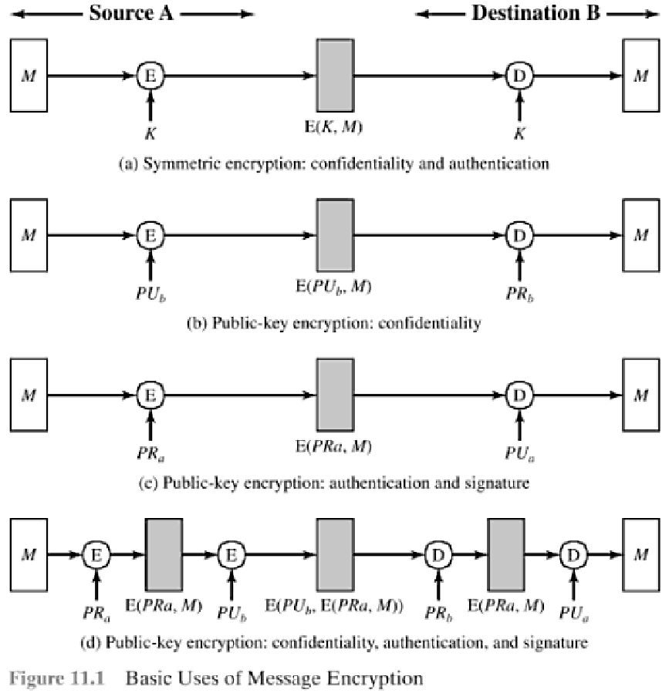
Uses of Message Encryption

Slide 76
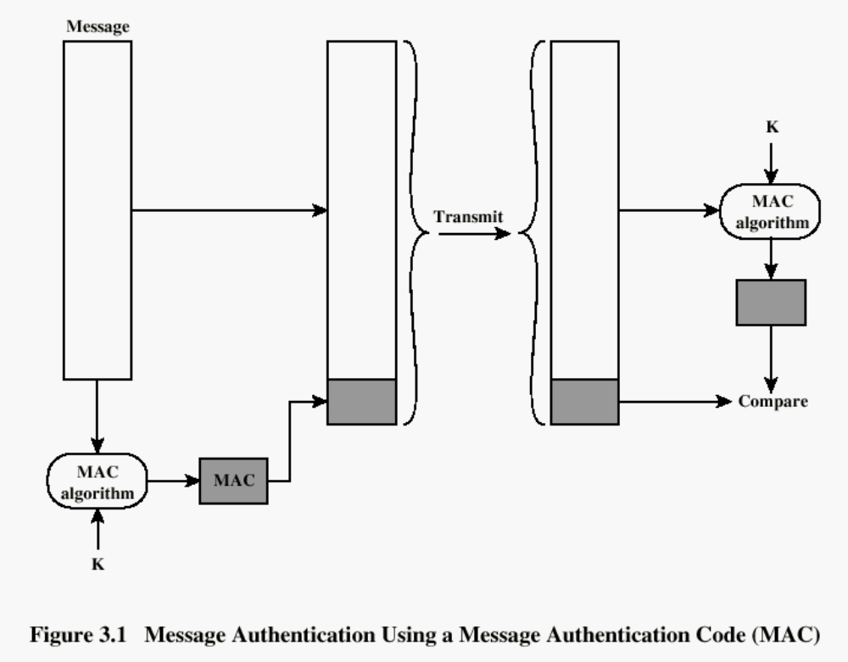

Slide 77
Hash Functions
h = H(M)
  Condenses arbitrary message to fixed size
  usually assume that the hash function is public and not keyed
    MAC needs to be keyed
hash used to
  detect changes to message
    most often to create a digital signature
Notes:
A variation on the message authentication code is the one-way hash function. As with the message authentication code, a hash function accepts a variable-size message M as input and produces a fixed-size output, referred to as a hash code H(M). Unlike a MAC, a hash code does not use a key but is a function only of the input message. The hash code is also referred to as a message digest or hash value.

Slide 78
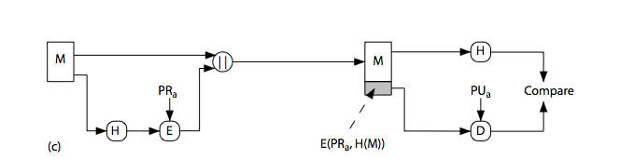
Hash Functions &
Digital Signatures
Notes:
Stallings Figure 11.5c “Basic Uses of Hash Functions” shows the hash being “signed” with the senders private key, thus forming a digital signature.

Slide 79
Requirements for Hash Functions
Purpose of the HASH function is to produce a ”fingerprint”
can be applied to any sized message M
produces fixed-length output h
easy to compute h=H(M) for any message M
given h, infeasible to find x s.t. H(x)=h
    one-way property
given x, infeasible to find y s.t. H(y)=H(x)
    weak collision resistance
infeasible to find any x,y s.t. H(y)=H(x)
    strong collision resistance
Notes:
The purpose of a hash function is to produce a “fingerprint”of a file, message, or other block of data.
These are the specifications for good hash functions. Essentially it must be extremely difficult to find 2 messages with the same hash, and the hash should not be related to the message in any obvious way (ie it should be a complex non-linear function of the message). There are quite a few similarities in the evolution of hash functions & block ciphers, and in the evolution of the design requirements on both.

Slide 80
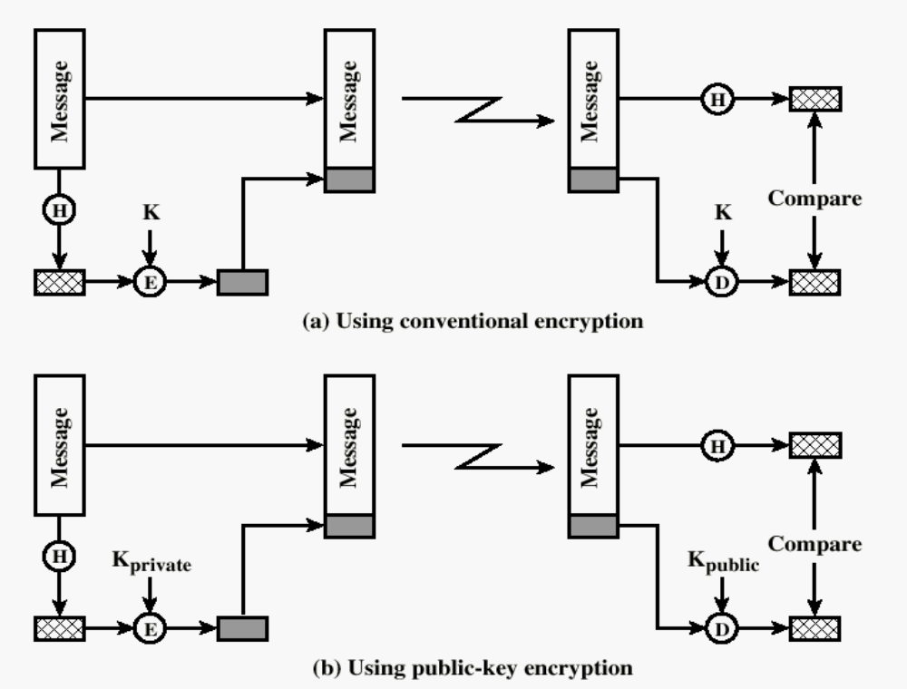
One-way HASH function

Slide 81
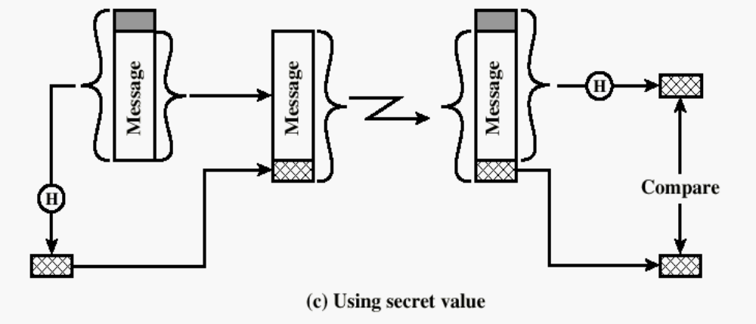
One-way HASH function
Secret value is added before the hash and removed before transmission.

Slide 82
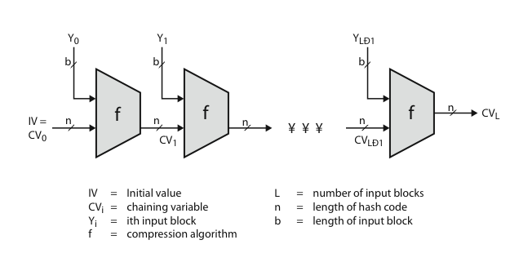
Hash Algorithm Structure
Notes:
Most important modern hash functions follow the basic structure shown in this figure, Stallings Figure 11.9. This has proved to be a fundamentally sound structure, and newer designs simply refine the structure and add to the hash code length. Within this basic structure, two approaches have been followed in the design of the compression function, as mentioned previously, which is the basic building block of the hash function.

Slide 83
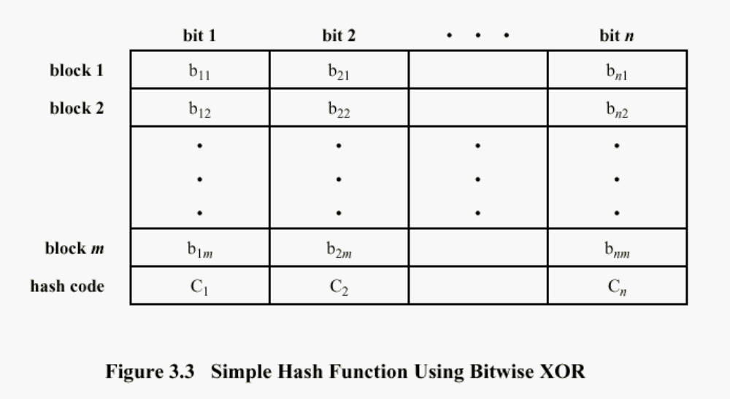
Simple Hash Function
Improvement
  One-bit circular shift on the hash value after each block is processed

Slide 84
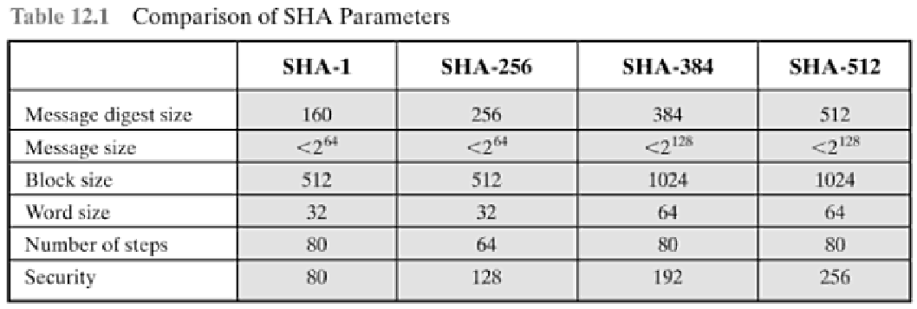
Secure Hash Algorithm
SHA
  originally designed by NIST & NSA in 1993
  revised in 1995 as SHA-1
  based on design of MD4 with key differences
3 additional versions of SHA
  SHA-256, SHA-384, SHA-512
    structure & detail is similar to SHA-1
Notes:
The Secure Hash Algorithm (SHA) was developed by the National Institute of Standards and Technology (NIST) and published as a federal information processing standard (FIPS 180) in 1993; a revised version was issued as FIPS 180-1 in 1995 and is generally referred to as SHA-1. The actual standards document is entitled Secure Hash Standard. SHA is based on the hash function MD4 and its design closely models MD4. SHA-1 produces a hash value of 160 bits. In 2005, a research team described an attack in which two separate messages could be found that deliver the same SHA-1 hash using 2^69 operations, far fewer than the 2^80 operations previously thought needed to find a collision with an SHA-1 hash [WANG05]. This result should hasten the transition to newer, longer versions of SHA.

Slide 85
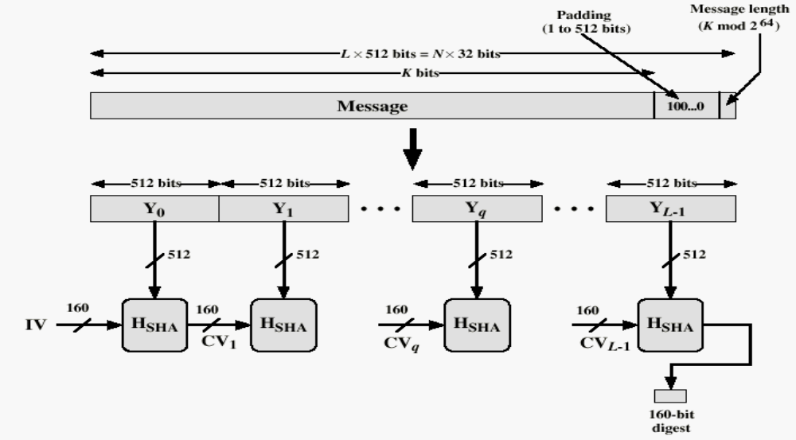
Message Digest Generation Using SHA-1
Step 1: append padding bits 100..0
Step 2: Append original msg length (128 bits)
Total length is a multiple of 512 bits
Step 3: Initialize hash buffer (IV)
Step 4: Process msg in 512-bit blocks

Slide 86
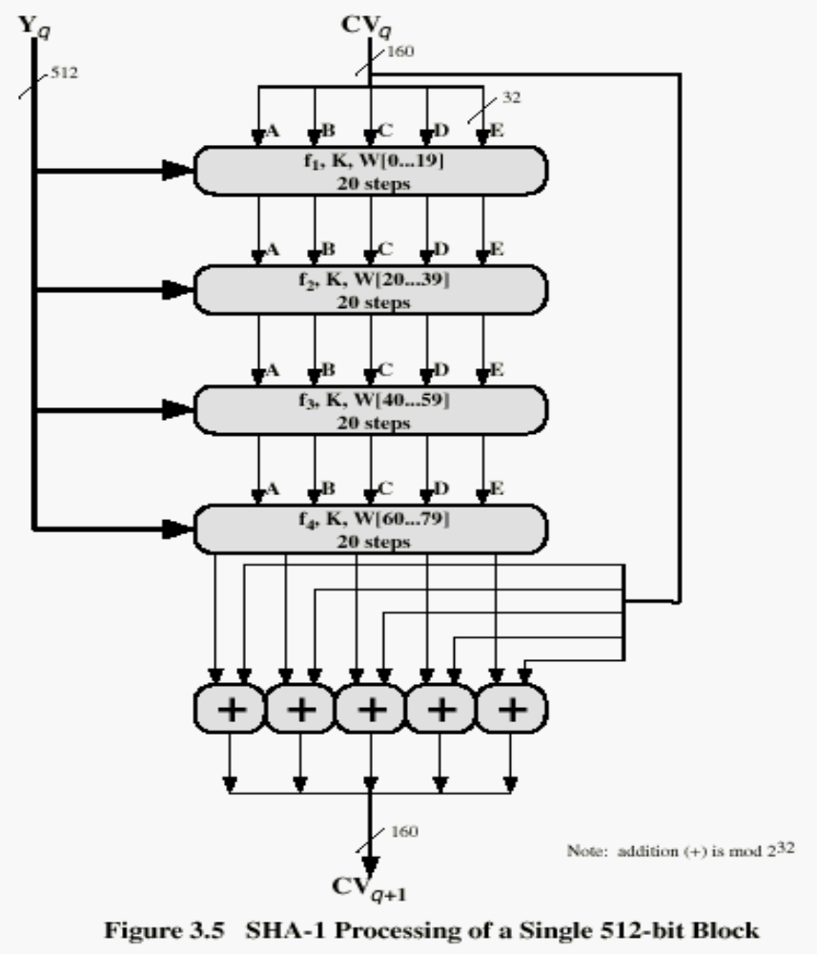
SHA-1 Processing of single 512-Bit Block

Slide 87

Comparison of Secure HASH functions
 | SHA-1 | MD5 | RIPEMD-160
Digest length | 160 bits | 128 bits | 160 bits
Basic unit of processing | 512 bits | 512 bits | 512 bits
Number of steps | 80 (4 rounds of 20) | 64 (4 rounds of 16) | 160 (5 paired rounds of 16)
Maximum message size | 2⁶⁴-1 bits

Slide 88
HMAC
HMAC (hash-based MAC)
  Incorporate a secret key into an existing hash algorithm
    Use a MAC derived from a cryptographic hash code
    Keyed hash digest
  Any hash function can be used
    eg. MD5, SHA-1, RIPEMD-160, Whirlpool
Motivations:
  Speed
    hash functions faster than encryptoin algorithms
    DES is much slower
  Availability
    Library code for cryptographic hash functions is widely available
  No export restrictions from the US

Slide 89
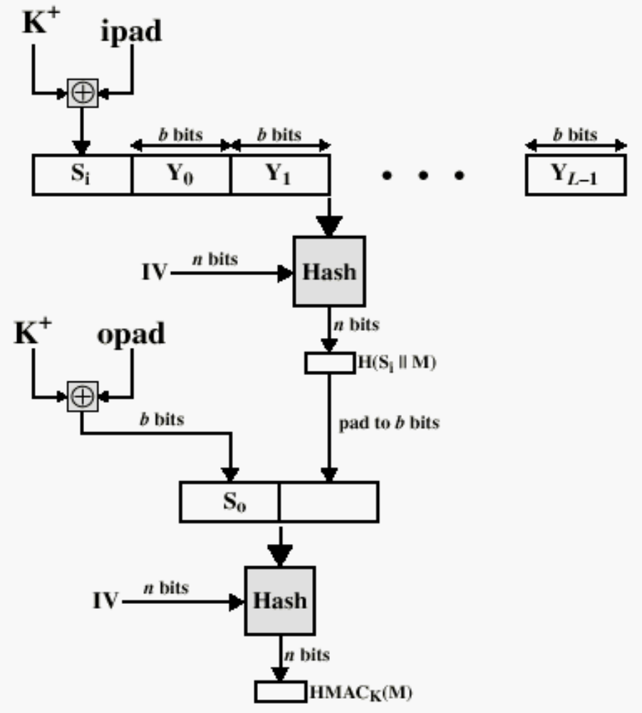
HMAC Structure
K+: secret K padded with 0’s on the left to make it b-bit long

